Slide 1
Sentia Assignement
Abhishek Jaiswal
Azure DevOps Engineer

Slide 2
Requirement
There are currently hosting 10 WordPress sites using WordPress Multisite in a private datacentre. They achieve high availability (HA) by using 2 servers and having two copies of their Multisite. For the database, they are using 2 MySQL servers behind and HAProxy to achieve HA.
The past few months, they have been having a lot of issues because some of their websites have increased in popularity, especially during certain timeframes. For the future state, they have agreed that they want to move away from Multisite, and have independent WordPress applications. They have also pointed out that they have 5 more sites in the making that will reach Production in the next 12 months.
The client is only interested in developing the WordPress sites from an application perspective. They work using GIT repositories, and they have agreed to provide access to the application source code in one or more repositories.

Slide 3
Solution
There are many ways to achieve the solution for the given requirement. The one way is using IAAS (Infrastructure as a Service), were we deploy virtual machine in a scale set along with MySQL database. And then deploy the WordPress site on the virtual machine. But to take the advantage of cloud service I have chosen to go for PAAS solution. Now in PAAS solution as well there are 2 options the one is webapp image with WordPress where the MySQL db will be deployed locally on the webapp. But in order to have more control over the application and database, I have decided to deploy the WordPress site on a webapp and MySQL database.

Slide 4
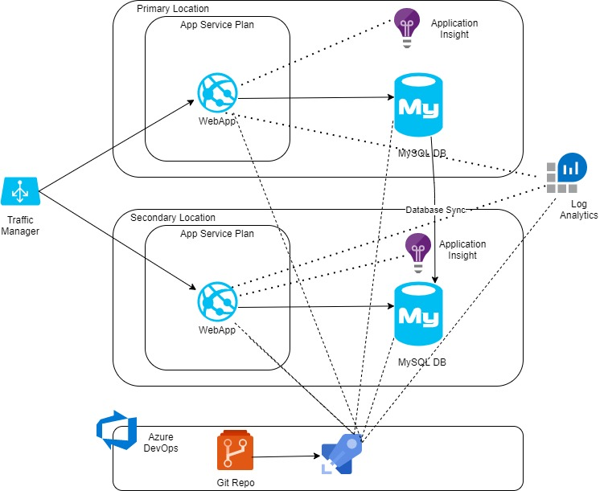
Architecture Diagram

Slide 5
Architecture explaination
In this architecture, there will be 2 region in Azure. Both the regions will be identical in a Active-Passive manner. Each region will contain an Azure webapp in which WordPress application will be deployed. The MySQL database is needed for WordPress application. The resources will be configured with diagnostics configuration which will store all the logs to log analytics workspace for monitoring. The Application insight will be configured for app level monitoring. An Azure traffic manager will be configured to manage the request to primary/Secondary location. In case of failure in the primary region the traffic manager will start sending the request to secondary region. The MySQL DB sync will be enabled from primary DB to secondary. All the resources will be deployed using Azure DevOps pipeline.

Slide 6
Pipeline Configuration
The pipeline needs to be configured in a sequence. We will go through the each steps of the application:
Stage 1 (Deploy Resource): In this stage all the Azure resources will be deployed.
A resource group will be deployed
The MySQL database will be deployed
An App service plan will be deployed
The Azure web app will be deployed
A new database will be created in MySQL server which will be used by WordPress application deployment
A traffic manager will be deployed
Stage 2 ( Build and Deploy WordPress): In this stage the WordPress application will be deployed.
The WordPress application code will be archived in Zip format
A new staging environment will be created
The application will be deployed to Azure WebApp
Switch the staging slot to primary

Slide 7
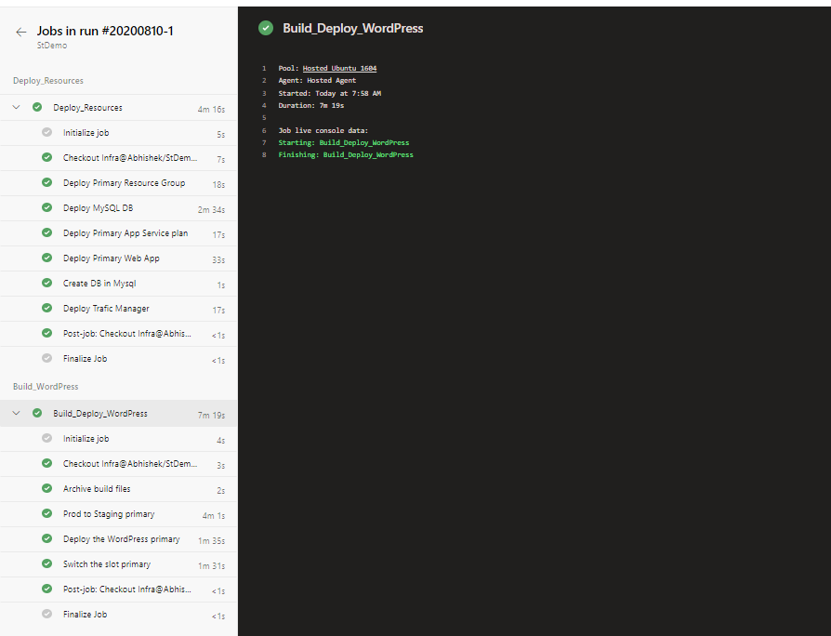
Pipeline ScreenShot

Slide 8
Demo
Now we will show the demo by running the pipeline and deploying all the resources

Slide 9

Thank you

